Slide 1
HIV in women in the EU/EEA: 25 years of surveillance data to inform prevention and control
Anastasia Pharris, Otilia Mårdh, Chantal Quinten and the ECDC HIV Surveillance Network
ESCAIDE, 28 November 2019

Slide 2
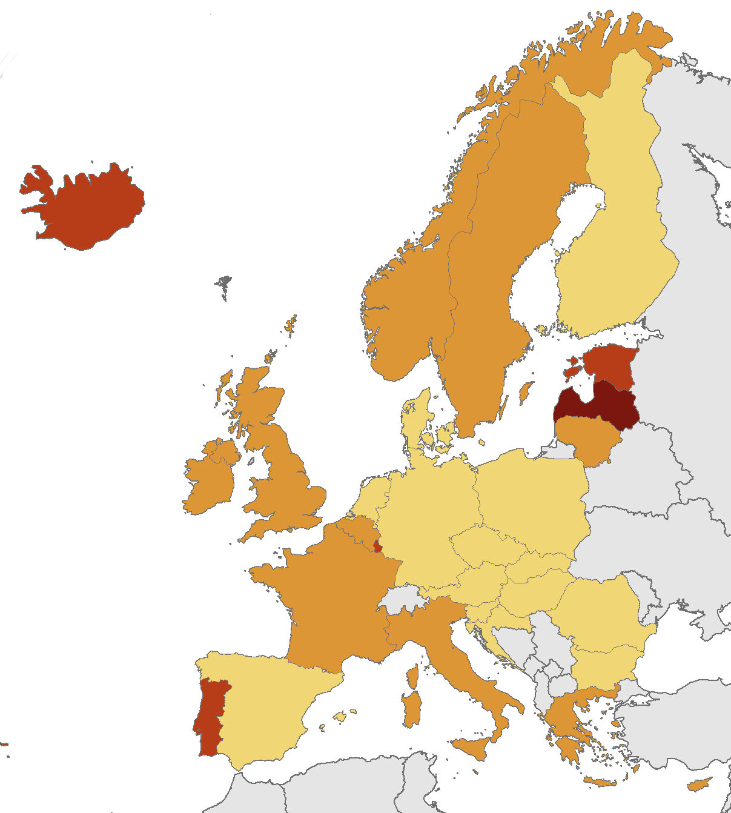
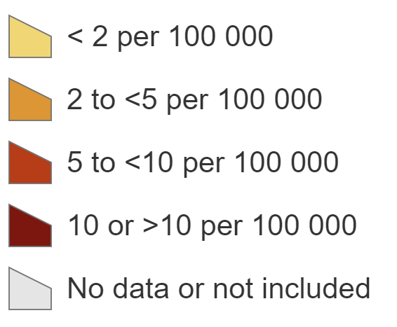
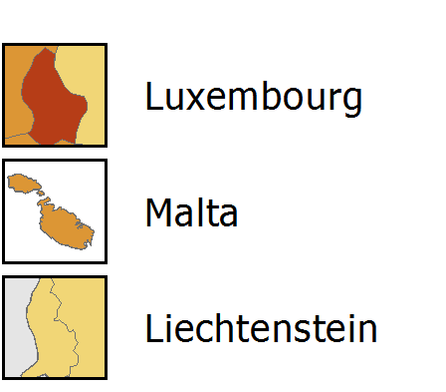
New HIV diagnoses in women, 2018, EU/EEA
Rate per 100 000 female population
EU/EEA rate 2.8 per 100 000
Non-visible countries
Source: ECDC/WHO (2018). HIV/AIDS Surveillance in Europe 2019– 2018 data

Slide 3
Background
25,000 - 30,000 individuals diagnosed with HIV annually in the EU/EEA
Male-female ratio 3.1:1
Limited HIV prevention focus on women in many countries
Study aim: To estimate HIV incidence and to describe the characteristics of women diagnosed with HIV from 1992-2017

Slide 4

Methods
New HIV diagnoses in women reported by the 31 EU/EEA countries to the European Surveillance System were extracted and corrected for reporting delay with the ECDC HIV Estimates Accuracy Tool
We calculated
  Overall and age-specific rates per 100 000 population, proportions per transmission mode and region of origin (1992-2017)
  Median CD4 cell count (2002-2018)
  Incidence and the number of women living with HIV in the EU/EEA were estimated with the ECDC HIV Modelling Tool (2003- 2018)

Slide 5
HIV notification rates in men and women, EU/EEA

Slide 6
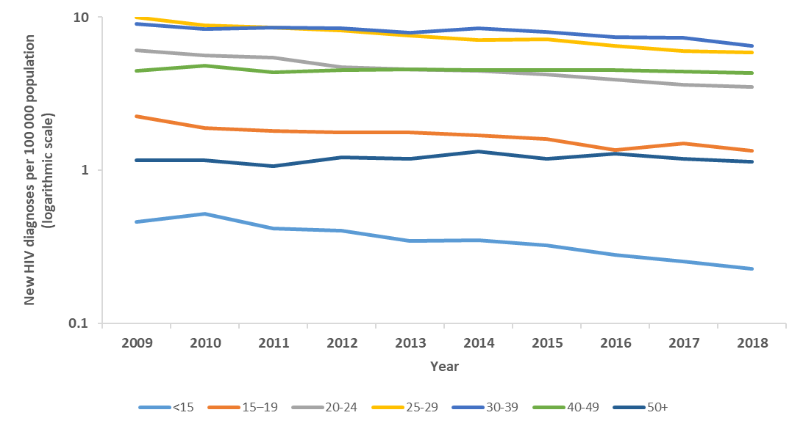
Age-specific rates in women diagnosed with HIV, EU/EEA

Slide 7
Age distribution in women diagnosed with HIV, EU/EEA
Notes:
Mean age 26-27 years in 1990s and 37-38 years in 2017

Slide 8
HIV transmission route in women diagnosed with HIV, EU/EEA
Notes:
Hetero 60% in 1990s → >90% since 2004
IDU 19% in 1992 → 3.5% in 2017

Slide 9
Region of origin of women diagnosed with HIV, EU/EEA
Notes:
Proportion of new diagnoses in women native to the reporting country was high in the 1990s, declined in the early 2000 to about 30% of new diagnoses, and then has increased again to about 37%.
The majority of new diagnoses are among migrant women. Women from countries in sub-Saharan Africa predominate and comprised about 1/3 of new diagnoses in the 1990s, increasing to more than half of new diagnoses in the early 2000s and then decreasing again to about 43% of new diagnoses in 2017.
Proportion of new diagnoses in women from elsewhere in Europe has tripled from 3% in 1992 to 9% in 2014-2017

Slide 10
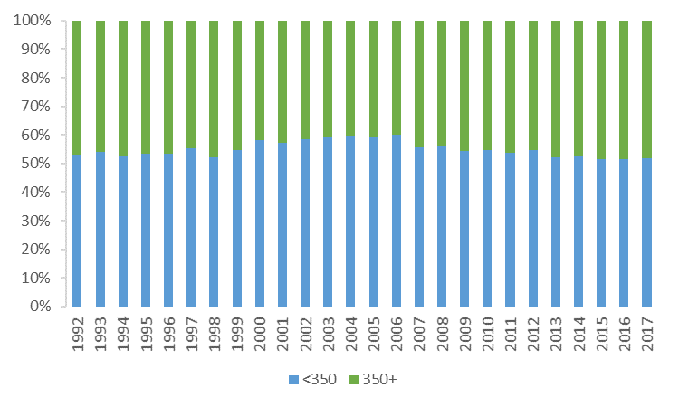
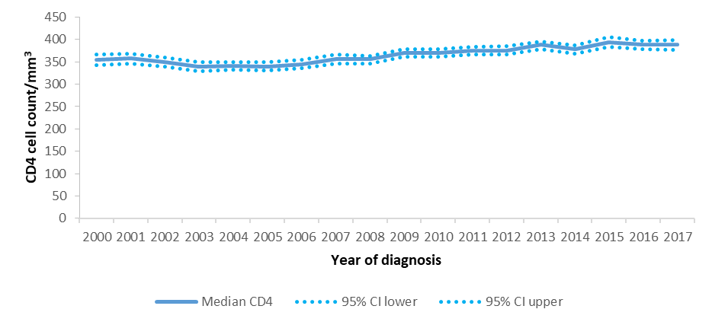
CD4 cell count at HIV diagnosis in women, EU/EEA
Median CD4 cell count at HIV diagnosis
Proportion of diagnoses at CD4 <350 cells /mm³
Notes:
Median CD4 cell count at HIV diagnosis has been increasing over time, from 290 in 2000 to 333 in 2017. Still the proportion of women diagnosed at a CD4 cell count of <350 is more than half throughout entire 25 year period, with little variation. In 2017, still one in two women diagnosed with HIV were diagnosed late.

Slide 11
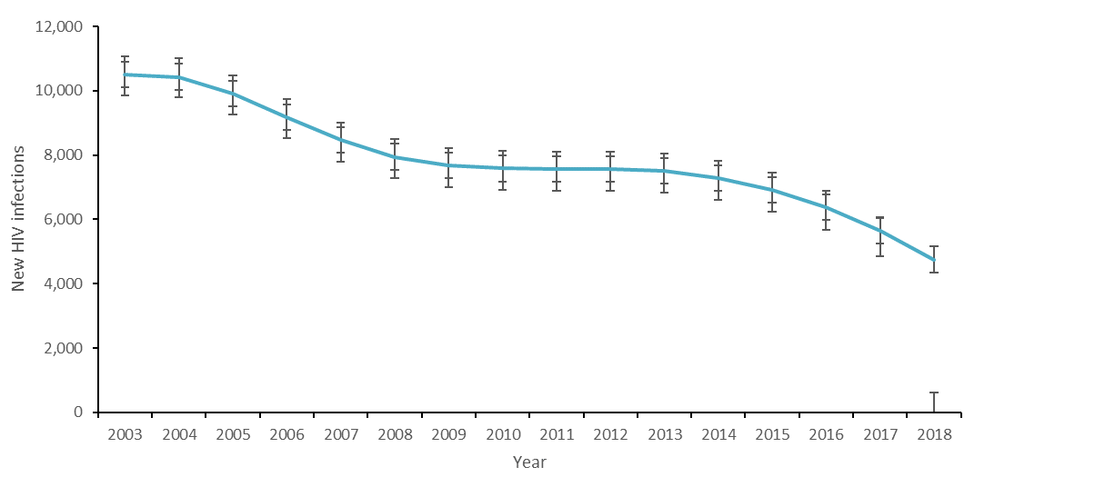
Estimated HIV incidence in women, EU/EEA
4750 (4427-4860)
new HIV infections
2018

Slide 12
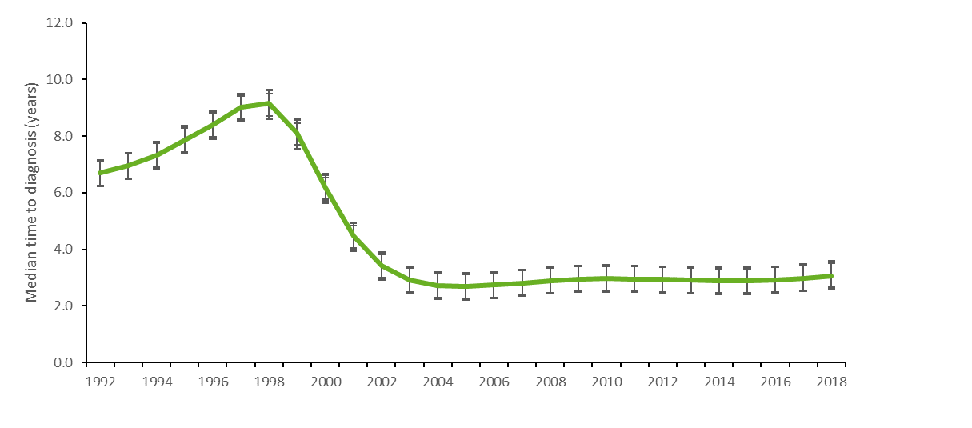
Estimated time from HIV infection to diagnosis in women, EU/EEA

Slide 13
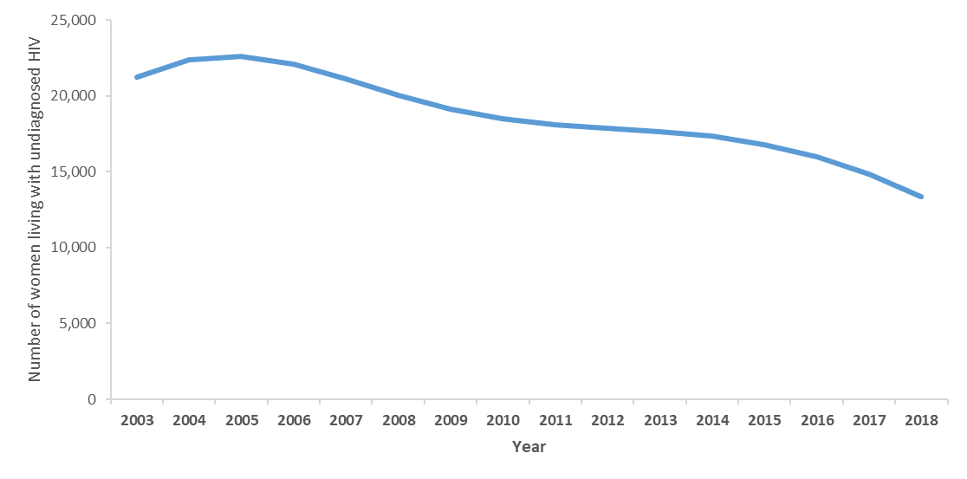
Estimated number of women living with HIV in the EU/EEA
208,800 women living with HIV in the EU/EEA in 2018 (0.08% prevalence)
13,300 women living with undiagnosed HIV
  6.4% undiagnosed (95% CI 6.2-6.6%)

Slide 14
Limitations
Incomplete data on transmission route, CD4 cell count, partner risk
<100% coverage of HIV surveillance at national level, in particular before 2003
Estimation of incidence and the number of women living with HIV challenging due to in and out-migration

Slide 15
In summary
Women diagnosed with HIV in recent years are older, more likely to have acquired HIV through heterosexual transmission, more likely to be born abroad than women diagnosed in the 1990s.
HIV incidence in women has declined since 2004
Median CD4 cell count/mm³ at HIV diagnosis is improving, but still 48% of women are diagnosed late. 3 years from infection to diagnosis.
13,300 women are living with undiagnosed HIV in the EU/EEA.

Slide 16
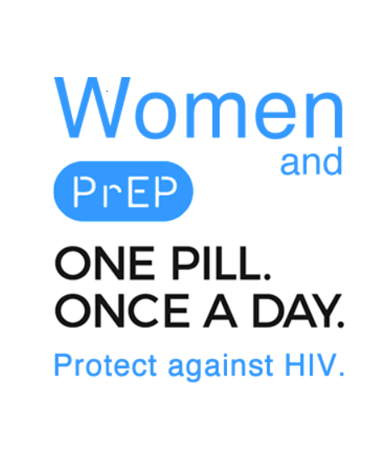
Strengthen HIV prevention strategies for women
Pre-exposure prophylaxis for HIV
  Reaching heterosexual women, older women, migrant women
Strategies linked to partner risk
  Inclusion of sexual partners in targeted prevention efforts for bisexual men and men who inject drugs
  STI screening and partner notification
Harm reduction for women who inject drugs

Slide 17
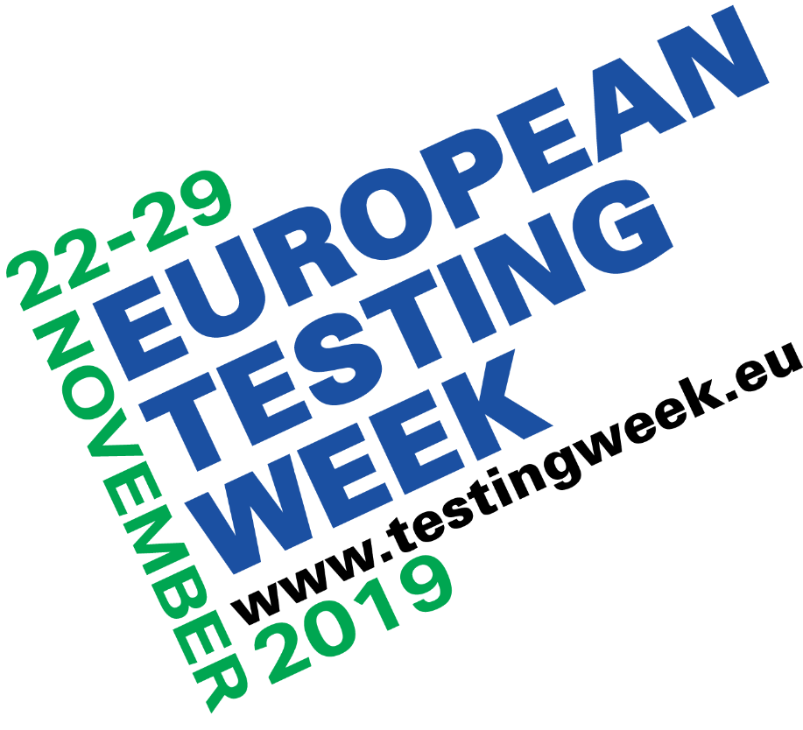
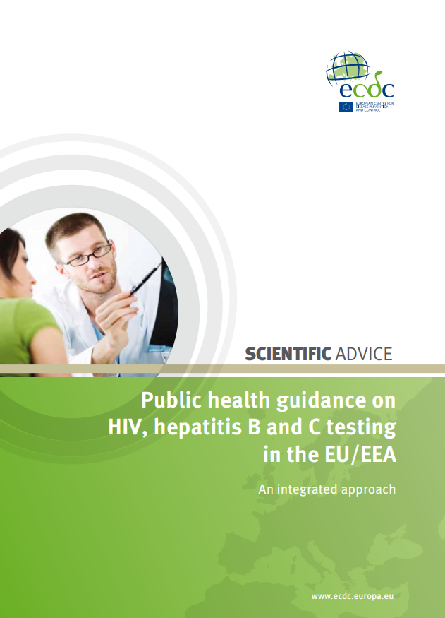
Strengthen testing programmes for women
Antenatal screening
Sexual health clinics
Effective and recommended approaches to increasing testing uptake and earlier diagnosis
Low coverage of effective testing interventions in most European countries.
Expand strategies to reach women for earlier HIV testing, especially older women and migrant women.
Provider-initiated testing in health care settings
Community testing
Pharmacies
Prisons
Indicator condition testing
Self-testing/
self-sampling
Partner notification

Slide 18
Thank you!
EU/EEA HIV Surveillance Focal Points
Austria: Daniela Schmid, Ziad El-Khatib; Belgium: Andre Sasse, Dominique Van Beckhoven; Bulgaria: Tonka Varleva; Croatia: Tatjana Nemeth Blazic; Cyprus: Linos Hadjihannas, Maria Koliou; Czech Republic: Marek Maly; Denmark: Susan Cowan; Estonia: Kristi Rüütel; Finland: Kirsi Liitsola, Mika Salminen; France: Françoise Cazein, Josiane Pillonel, Florence Lot; Germany: Barbara Gunsenheimer-Bartmeyer; Greece: Vasilios Raftopoulos, Stavros Patrinos; Hungary: Maria Dudas; Iceland: Haraldur Briem, Gudrun Sigmundsdottir; Ireland: Derval Igoe, Kate O’Donnell; Italy: Barbara Suligoi; Latvia: Šarlote Konova; Liechtenstein: Andrea Leibold, Marina Jamnicki; Lithuania: Irma Čaplinskienė; Luxembourg: Aurelie Fischer, Jean-Claude Schmit; Malta: Jackie Maistre Melillo, Tanya Melillo; Netherlands: Eline Op de Coul, Ard van Sighem; Norway: Hans Blystad; Poland: Magdalena Rosinska; Portugal: Isabel Aldir, Helena Cortes Martins; Romania: Mariana Mardarescu; Slovakia: Peter Truska; Slovenia: Irena Klavs, Tanja Kustec, Maja Milavec; Spain: Asuncion Diaz; Sweden: Maria Axelsson; United Kingdom: Valerie Delpech
ECDC Colleagues
Andrew Amato, Teymur Noori, Adrian Prodnan
WHO Regional Office for Europe
Giorgi Kuchukhidze, Nicole Seguy, Annemarie Stengaard, Stine Nielsen, Masoud Dara

Slide 19

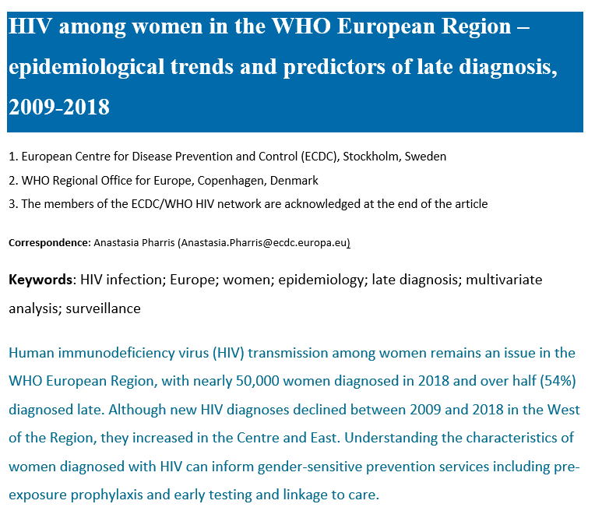
For more information
www.ecdc.europa.eu
www.eurosurveillance.org

